Slide 1
Cloud Data Marketplace
Order Management
Prototype

Slide 2
What are we trying to do?
Cloud Data Marketplace is intended to easily publish collections and manage the approval process workflow for consumers and publishers.
With a little coding, and the API, we can automate the fulfillment of such collections, thus removing a manual step.

Slide 3


The approach
The challenge, is that CDMP may be used to help deliver any possible collection. So, the approach is to separate the order management into two tasks.
Order Management: Find what orders have been approved and collect the necessary information
Source Fulfillment: Fulfill the actual request (Example: Snowflake)
Think of it as a message in a bottle. When you throw the message in the ocean, you don’t know who will answer. Using this approach allows anyone to extend it to add more sources
Order Management
Snowflake Fulfillment

Slide 4
The Files
Order_management.py
cdmp_api.py
my_encrypt.py
These are used for the “Order Management” island
Orders.csv
This is the message in a bottle
xxx_orders.py
my_encrypt.py
xxx_collections.csv
user_groups.csv *optional
These are used for the “Snowflake Fulfillment” island
Order Management
Snowflake Fulfillment

Slide 5
Order Management
Will use the API to find any orders that have been approved, and are awaiting fulfillment / withdraw
It will then insert / update the order in the orders.csv
Order Management
Order_management.py will write to the following fields:
OrderId
OrderDate
OrderJustification
CollectionNames
CollectionOwnerNames
CollectionOwnerEmails
RequestorName
RequestorUsername
Email
TermsOfUse
Usage
DeliveryTargetID
DeliveryTargetName
DeliveryTargetLocation
DeliveryTargetMethod
DeliveryTargetFormat
CostCenter
AccessId

Slide 6
Snowflake/Sqlserver/Oracle/AWS Fulfilment
Read the order.csv
Make whatever connections and fulfill the request
Connect and grant or revoke a role
Update the orders.csv to message that the order was fulfilled
XXX Fulfillment
xxx_orders.py will write to the following fields:
FulfillmentStatus
FulfillmentComment
WithdrawStatus
WithdrawComment

Slide 7
Order Management
Read the orders.csv
Using the API it will update the Order with the Fulfillment / Withdraw
Update the orders.csv that it’s complete
Order Management
Order_management.py will write to the following fields:
OrderStatus
AccessStatus

Slide 8
Extendible
Using this back-and-forth approach, allows us to extend the capability more easily. By just writing code for the fulfillment, without having to rewrite the Order management piece.
We have a new order
It’s Snowflake, I fulfilled it
Snowflake Fulfillment
Order Management
It’s Sqlserver, I fulfilled it
It’s AWS, I fulfilled it
It’s xxx, I fulfilled it
Sqlserver Fulfillment
AWS Fulfillment
xxx Fulfillment

Slide 9
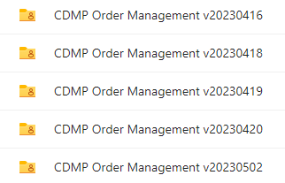
Get the Assets for CDMP Order Management
Wiki Page:
https://infawiki.informatica.com/pages/viewpage.action?pageId=630698589
NA Data Governance Solution Architects Content ->
Cloud Data Marketplace ->
CDMP Order Management & Automatic Fulfillment ->
Download the latest version here. ->
Download the latest version:

Slide 10
Cloud Data Marketplace
Order Management
Setup

Slide 11
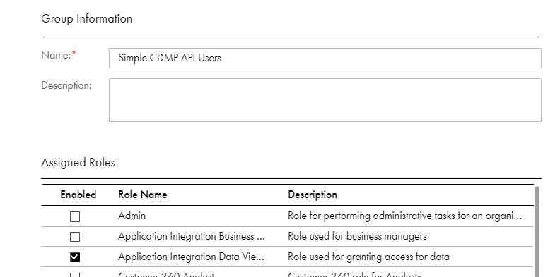
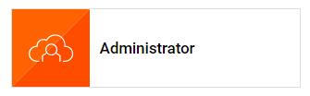
Setup Step 1
In Informatica - Administrator: Create a group named "Simple CDMP API Users".
Add Role "Application Integration Data Viewer" to that group.
Add one or more users that will execute the APIs. This will be the user hat will be shown to have fulfilled orders.

Slide 12
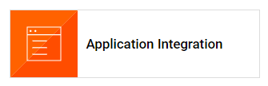

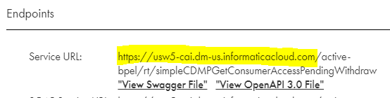
Setup Step 2
In Informatica - Application Integration - Explore: Import the "SimpleCDMP APIs Informatica Export.zip" file.
Be sure to select "Publish Application Integration assets after import"
Accept all other defaults
This will create a Project called "SimpleCDMP APIs" and the following processes, and they should all be published.
Open one of these processes that were created -> Click the 3 dots -> Click Properties Detail...
Note the beginning of the Service URL for later use.
Example: https://usw5-cai.dm-us.informaticacloud.com

Slide 13
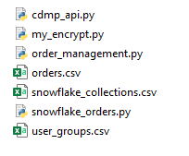
Setup Step 3
Unzip the python files (CDMP_Order_Management_Python.zip) anywhere that you have access to the Org and Snowflake (windows is fine, as long as python is installed)

Slide 14
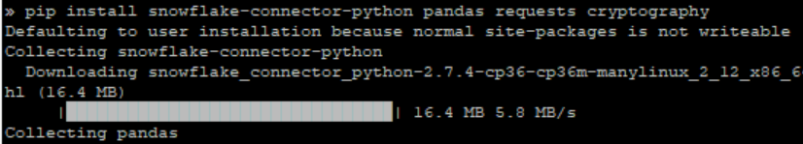
Setup Step 4
Using "pip" ensure the required libraries are installed
pip install pandas requests cryptography jaydebeapi boto3 awscli botocore getpass configparser
or
pip3 install pandas requests cryptography jaydebeapi boto3 awscli botocore getpass configparser

Slide 15
Setup Step 5
Run Config script to generate config.ini file. You will be prompted for these parameters (or choose to keep the existing parameter): python3 config.py or python config.py
Each section has an “enable” option. So if you’re not using a particular feature, you will not need to provide those parameters
Section | Name | Note
Snowflake | username | Username for Snowflake Connection Example: SHAYES
Snowflake | encrypted_password | Password for above user (will be encrypted) Example: odyrea$1234
Databricks | enable | Enable Databricks Logic Example: y
Databricks | jdbc_url | JDBC URL for Databricks Connection Example: jdbc:databricks://adb-3507816793016728.8.azuredatabricks.net:443/default;transportMode=http;ssl=1;AuthMech=3;httpPath=/sql/1.0/endpoints/556b3ac6518656a2;
Databricks | username | Username for Databricks Connection Example: token
Databricks | encrypted_password | Password for above user (will be encrypted) Example: odyrea$1234
Oracle | enable | Enable Oracle Logic Example: 1
Oracle | jdbc_url | JDBC URL for Oracle Connection jdbc:oracle:thin:@(description= (retry_count=20)(retry_delay=3)(address=(protocol=tcps)(port=1522)(host=adb.us-ashburn-1.oraclecloud.com))(connect_data=(service_name=gddcdc5b5db156e_cdgc_medium.adb.oraclecloud.com))(security=(ssl_server_dn_match=yes)))
Oracle | username | Username for Oracle Connection Example: ADMIN
Oracle | encrypted_password | Password for above user (will be encrypted) Example: odyrea$1234
Section | Name | Note
IDMC | debug | Enable Debug messages in log? Example: false
IDMC | username | IDMC Username for connecting to Data Marketplace and Cloud Data Integration Example: shayes_infa
IDMC | encrypted_password | Password for above user (will be encrypted) Example: odyrea$1234
IDMC | cai_api_url_base | URL Base used for CAI calls Example: https://usw5-cai.dm-us.informaticacloud.com
IDMC_CDI | enable | Enable Mapping Task logic Example: True
IDMC_CDI | url_base | Main Base of the env Example: https://dm-us.informaticacloud.com
IDMC_CDI | pod_url_base | Pod (Region) URL Base Example: https://usw5.dm-us.informaticacloud.com
IDMC_CDI | hawk_url_base | CDGC API URL Base Example: https://cdgc-api.dm-us.informaticacloud.com
Snowflake | enable | Enable Snowflake logic Example: 1
Snowflake | jdbc_url | JDBC URL for Snowflake Connection Example: jdbc:snowflake://eeb76041.snowflakecomputing.com:443/

Slide 16
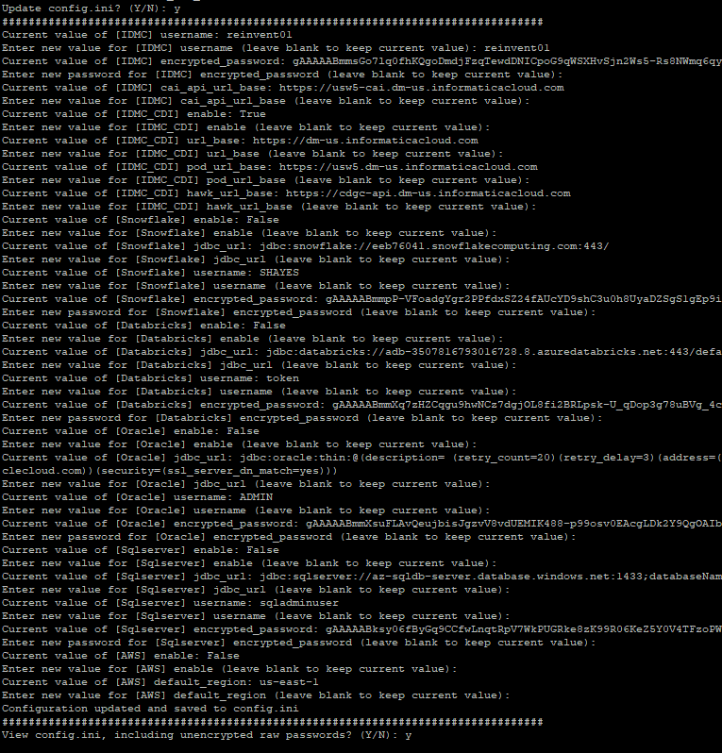
Setup Step 5 (continued)
Section | Name | Note
Sqlserver | enable | Enable Sqlserver Logic Example: N
Sqlserver | jdbc_url | JDBC URL for Databricks Connection Example: jdbc:sqlserver://az-sqldb-server.database.windows.net:1433;databaseName=NSEN;encrypt=true;
Sqlserver | username | Username for Sqlserver Connection Example: sqladminuser
Sqlserver | encrypted_password | Password for above user (will be encrypted) Example: odyrea$1234
AWS | enable | Enable AWS Lafe Formation Logic Example: 1
AWS | default_region | Default AWS Region to use for connection Example: us-east-1
This will modify the config.ini file, and optionally, allow you to display all the values, to verify.
Of course, you also have the option of modifying the config.ini manually, but this will not allow you to change encrypted passwords, easily

Slide 17

Setup Step 6 (if using AWS Lake formation delivery)
If using AWS, Create an AWS credentials file on the box where executing as noted below.

Slide 18
Setup Step 7 (if using Snowflake delivery)
Modify the snowflake_collecions.csv, sqlserver_collections.csv, and oracle_collections.csv file as follows:
collection: This is the name of the collection. It should match the name in Cloud Marketplace
DeliveryTargetName: This is the name of the Delivery Template. It should match the name in Cloud Marketplace. (Set this to “ANY” to ignore the Delivery Template)
TermsOfUse: This will be the name of the Terms of use to be evaluated. (Set this to “ANY” to ignore the TermsOfUse)
Usage: This is the name of the Usage Context. (Set this to “ANY” to ignore the Usage)
Usergroup: Set this, if you want the collection fulfilled for a specific Usergroup (defined in the next step). (Set this to “ANY” to ignore the Usergroup)
role: This is the Snowflake role that will be granted or revoked.
comment: This is the comment that will be added to the order when fulfilled.
withdraw_comment: This is the comment that will be added to the order when withdrawn.
overrideUser: If not blank, it will always use this user. (used for demos). If blank, it will use the Requestor email to lookup the Snowflake user.

Slide 19
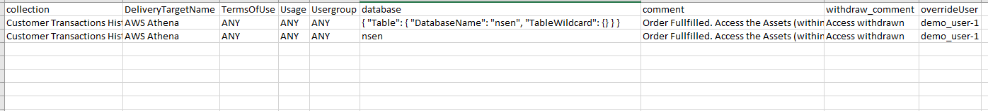
Setup Step 8 (if using AWS Lake Formation delivery)
Modify the aws_lakeformation_collections.csv file as follows:
collection: This is the name of the collection. It should match the name in Cloud Marketplace
DeliveryTargetName: This is the name of the Delivery Template. It should match the name in Cloud Marketplace. (Set this to “ANY” to ignore the Delivery Template)
TermsOfUse: This will be the name of the Terms of use to be evaluated. (Set this to “ANY” to ignore the TermsOfUse)
Usage: This is the name of the Usage Context. (Set this to “ANY” to ignore the Usage)
Usergroup: Set this, if you want the collection fulfilled for a specific Usergroup (defined in the next step). (Set this to “ANY” to ignore the Usergroup)
database: This can be set to an AWS principal json, or you can just provide a database name, and it will grant/revoke access to the entire database
comment: This is the comment that will be added to the order when fulfilled.
withdraw_comment: This is the comment that will be added to the order when withdrawn.
overrideUser: If not blank, it will always use this user. (used for demos). If blank, it will use the Requestor email and username to lookup the AWS IAM Username.

Slide 20
Setup Step 9 (if using mapping task delivery)
Modify the mapping_task_collections.csv file as follows:
collection: This is the name of the collection. It should match the name in Cloud Marketplace
DeliveryTargetName: This is the name of the Delivery Template. It should match the name in Cloud Marketplace. (Set this to “ANY” to ignore the Delivery Template)
TermsOfUse: This will be the name of the Terms of use to be evaluated. (Set this to “ANY” to ignore the TermsOfUse)
Usage: This is the name of the Usage Context. (Set this to “ANY” to ignore the Usage)
Usergroup: Set this, if you want the collection fulfilled for a specific Usergroup (defined in the next step). (Set this to “ANY” to ignore the Usergroup)
list_of_acceptable_columns: Set this to “ALL”, or all, or if columns are not parameterized. A comma or semicolon list of columns to include in the parameter, or “Based on Comment”, to use the last comment on the order to determine columns.
original_mapping_task_id: the Id (from the CDI URL) of the mapping task to be used as a template.
container_id_for_new_mappings: the Id (from the CDI URL) of the folder where new mapping tasks will be created
target_table_parameter_labels: Semicolon separated list of parameter labels for target tables
field_mapping_parameter_labels: Semicolon separated list of parameter labels for field mapping parameters
pre_post_jdbc_connection_name: JDBC Connection name (Section name from config.ini), to be used for the pre and post steps
pre_create_statements: Pre “create” statements. Semi-colon delimited, used for creating tables. Tokens to be replaced: {tgt_table}, {new_table_name}, {user}
post_statements: Post statements. Semi-colon delimited, used for granting access. Tokens to be replaced: {tgt_table}, {new_table_name}, {user}
comment. This is the comment that will be added to the order when fulfilled. Tokens to be replaced: {user}, {tables}
withdraw_comment. Withdraw not supported yet. Not used
overrideUser. If not blank, it will always use this user. (used for demos).

Slide 21

Setup Step 10 *optional
If you want to use Usergroups as part of the matching process, you can define these Usergroups here.
When evaluating collections, if it matches the username, email, or full name against any of these columns, it will include them in the corresponding group name
Modify the user_groups.csv file as follows:
group: Name of the group that you will note in the snowflake_collections.csv
username (or the column can be called anything): the username to be included in this group
email (or the column can be called anything): the email to be included in this group
Etc. keep adding columns, if you want for other things to match against the RequestorEmail, RequestorName, or RequestorUsername

Slide 22
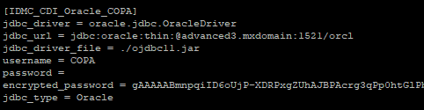
Setup Step 11 *optional (if using mapping task delivery)
If you are using Informatica’s Mapping Tasks for delivery of some collections, The “pre” and “post” statements can be used on a connection of your choosing. You can use any of the existing JDBC connections that have been shown in the config.ini
Optionally, you can create additional JDBC connections within the config.ini file to be used for this purpose.
If you are adding these, prefix these sections with “IDMC_CDI_”, and make sure they have the following parameters:
jdbc_driver
jdbc_url
jdbc_driver_file
username
password
encrypted_password
jdbc_type
Example:

Slide 23
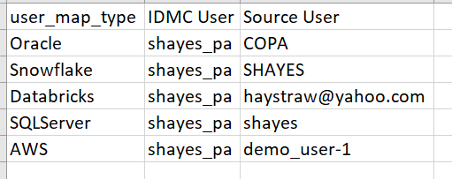
Setup Step 12 *optional
User Map. You can define a User Map to map IDMC users to specific “Source” users. This allows you to map when a specific user requests a collection, which user in Oracle, Snowflake, AWS, etc should be granted. This allows you to manually override any sort of internal lookup. In case you can’t use email, etc. to find the user.
Modify the user_map.csv file as follows:
user_map_type: Enter a type based on the source. Oracle, Snowflake, SqlServer, AWS, or Databricks
IDMC User: IDMC User that might request a collection
Source User: The corresponding user within the source system.

Slide 24

Setup Step 13
This script uses a JDBC connection, so ensure that you have a JAVA_HOME set
Example install Java on Linux:
yum install java-11-openjdk-devel

Slide 25
Setup Step 14
Run the "order_management.py" script
python order_management.py
or
python3 order_management.py
or
nohup python3 order_management.py &
or
nohup ./order_management.sh &
* Using the shell script will run it forever, and if errors occur, it’ll automatically restart it, making it very resilient

Slide 26
Script Output
If you’re able to see the script, this is the output that’s expected.
When you first Start up the script:
When there’s a new Order that’s been approved and is to be fulfilled:
When there’s a new Withdraw Request and is to be withdrawn:

Slide 27
Cloud Data Marketplace
Order Management
Errors & Additional Information

Slide 28
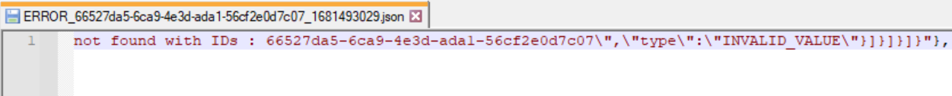
Errors
If there is an issue with the API and getting the initial fetching of orders, it’ll error quickly.
For example. If the password is wrong, or the permissions. It’s a prototype, so these errors may be ugly. ☺
If it has trouble later, when trying to update the Order, it will update the orders.csv “OrderStatus” field to error, and it will write the raw json response to a file named for the Order ID, so you can troubleshoot
Errors with the Fulfillment (of snowflake, for example), will note the error directly in the orders.csv file.

Slide 29
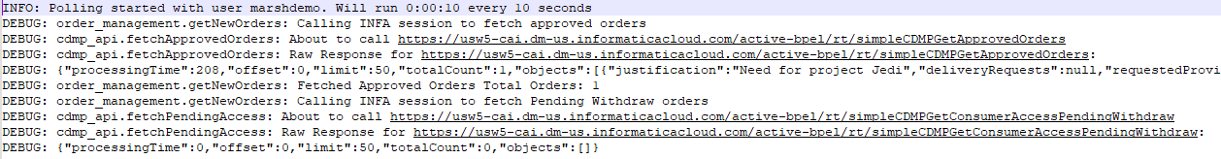
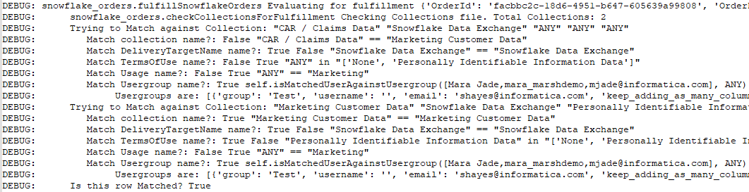
DEBUG
To turn on Debug, modify the config.ini and set debug = True Here’s some sample output:
Showing the raw API call, and the raw output
Part of the solution, is the matching of Orders to the appropriate “collections”. Since you can have it match on lots of criteria, this section shows exactly what it matched , and what it didn’t match.
This is useful to answer the question: “Why didn’t it find my order?”
Here’s the Order it’s looking at
Here are all the match criteria. Each line is an “or” so one of them needs to be true to match
This Collection Matches everything (or it’s set to ANY) EXCEPT Name. So, it’s NOT a Match
This Collection Matches everything (or it’s set to ANY)! Name, Delivery,Terms,Usage,Usergroup. So it’s a Match!

Slide 30
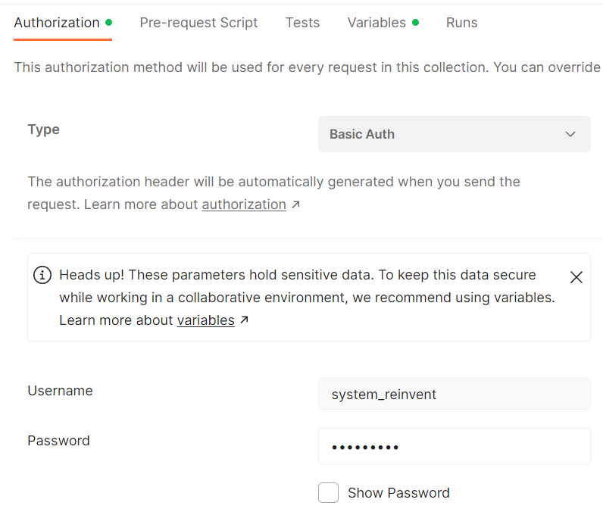
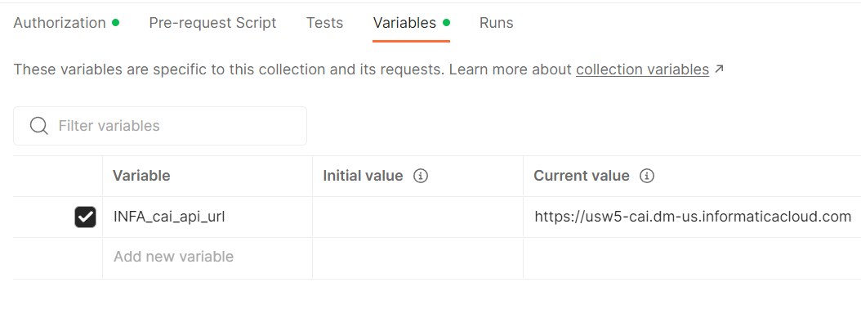
Postman Troubleshooting
I’ve also included a Postman Collection so you can troubleshoot, or run some of these APIs manually, at your leisure. You can import them using the file “SimpleCDMP APIs.postman_collection.json”. Within that postman collection You can modify the Basic authentication and the URL Collection Variable as you need.

Slide 31
Additional Snowflake Information (SQL Commands)
Just for your knowledge, these are the SQL Commands that were used to accomplish this:
CREATE ROLE "NSEN Marketing Data";
GRANT USAGE ON WAREHOUSE DEMO_WH TO ROLE "NSEN Marketing Data";
GRANT USAGE ON DATABASE NSEN TO ROLE "NSEN Marketing Data";
GRANT USAGE ON SCHEMA NSEN.NSEN TO ROLE "NSEN Marketing Data";
GRANT SELECT ON NSEN.NSEN.LARGE_TRANSACTIONS_ANALYTICS TO "NSEN Marketing Data";
GRANT SELECT ON NSEN.NSEN.NS_MKTG_ADDR TO "NSEN Marketing Data";
GRANT SELECT ON NSEN.NSEN.NS_MKTG_PROD TO "NSEN Marketing Data";
GRANT SELECT ON NSEN.NSEN.NS_MKTG_TRANS TO "NSEN Marketing Data";
GRANT SELECT ON NSEN.NSEN.NS_MKTG_USER TO "NSEN Marketing Data";
grant select on future tables in schema NSEN.NSEN to role "NSEN Marketing Data";
grant ROLE "NSEN Marketing Data" TO USER nsen_user;
revoke ROLE "NSEN Marketing Data" from USER nsen_user;

Slide 32
Additional SQLServer Information (SQL Commands)
/* in the master database*/
CREATE LOGIN mjade WITH PASSWORD = ‘xxx';
/* in the NSEN database*/
CREATE USER mjade FROM LOGIN mjade;
create role nsen_data_masked;
GRANT SELECT ON NSEN.masked.NSEN_TXN_SUMMARY to nsen_data_masked;
GRANT SELECT ON NSEN.masked.NS_RWD_PMETH to nsen_data_masked;
GRANT SELECT ON NSEN.masked.NS_RWD_PROD to nsen_data_masked;
GRANT SELECT ON NSEN.masked.NS_RWD_TRANS to nsen_data_masked;
GRANT SELECT ON NSEN.masked.NS_RWD_USER to nsen_data_masked;
/* grant or revoke role to mjade user*/
EXEC sp_addrolemember 'nsen_data_masked', 'mjade';
EXEC sp_droprolemember 'nsen_data_masked', 'mjade';

Slide 33
Additional Oracle Cloud Information (Commands) pt 1
/*create the role for raw read access*/
CREATE ROLE NSEN_READ_ACCESS;
GRANT SELECT ON NSEN.NS_RWD_PMETH TO NSEN_READ_ACCESS;
GRANT SELECT ON NSEN.NS_RWD_PROD TO NSEN_READ_ACCESS;
GRANT SELECT ON NSEN.NS_RWD_TRANS TO NSEN_READ_ACCESS;
GRANT SELECT ON NSEN.NS_RWD_USER TO NSEN_READ_ACCESS;
GRANT SELECT ON NSEN.USER_NOTES TO NSEN_READ_ACCESS;
/*grant or revoke access to raw data*/
GRANT NSEN_READ_ACCESS TO MARA;
REVOKE NSEN_READ_ACCESS FROM MARA;
/*explicitly grant access to tables to the masked schema (with grant option)*/
GRANT SELECT ON NSEN.NS_RWD_PMETH TO NSEN_MASKED with grant option;
GRANT SELECT ON NSEN.NS_RWD_PROD TO NSEN_MASKED with grant option;
GRANT SELECT ON NSEN.NS_RWD_TRANS TO NSEN_MASKED with grant option;
GRANT SELECT ON NSEN.NS_RWD_USER TO NSEN_MASKED with grant option;
GRANT SELECT ON NSEN.USER_NOTES TO NSEN_MASKED with grant option;
/*After masked objects are created, create role granting access to them*/
CREATE ROLE NSEN_MASKED_READ_ACCESS;
GRANT SELECT ON NSEN_MASKED.NS_RWD_PMETH TO NSEN_MASKED_READ_ACCESS;
GRANT SELECT ON NSEN_MASKED.NS_RWD_PROD TO NSEN_MASKED_READ_ACCESS;
GRANT SELECT ON NSEN_MASKED.NS_RWD_TRANS TO NSEN_MASKED_READ_ACCESS;
GRANT SELECT ON NSEN_MASKED.NS_RWD_USER TO NSEN_MASKED_READ_ACCESS;
GRANT SELECT ON NSEN_MASKED.USER_NOTES TO NSEN_MASKED_READ_ACCESS;

Slide 34
Additional Oracle Cloud Information (Commands) pt 2
/*grant or revoke access to masked data*/
GRANT NSEN_MASKED_READ_ACCESS TO MARA;
REVOKE NSEN_MASKED_READ_ACCESS FROM MARA;
Changed the Grant and Revoke variables in the python to include the procedure to build the synonyms:
grant_role_to_user = ["GRANT %(role)s to %(requesting_user)s", "call build_nsen_synonymns('%(requesting_user)s’)”]
revoke_role_from_user = ["REVOKE %(role)s from %(requesting_user)s","call build_nsen_synonymns('%(requesting_user)s')"]

Slide 35
Additional Databricks Information
/* grant & revoke access to use a specific schema*/
GRANT USE SCHEMA ON SCHEMA presales_unitycatalog.copa TO `haystraw@yahoo.com`;
REVOKE USE SCHEMA ON SCHEMA presales_unitycatalog.copa FROM `haystraw@yahoo.com`;
/* grant & revoke read to a specific table*/
GRANT SELECT ON TABLE presales_unitycatalog.copa.copa_details_test TO `haystraw@yahoo.com`;
REVOKE SELECT ON TABLE presales_unitycatalog.copa.copa_details_test FROM `haystraw@yahoo.com`;
/* grant & revoke read to all objects in a schema*/
GRANT EXECUTE, SELECT, READ VOLUME, USE SCHEMA ON SCHEMA presales_unitycatalog.nsen to `haystraw@yahoo.com`;
REVOKE EXECUTE, SELECT, READ VOLUME, USE SCHEMA ON SCHEMA presales_unitycatalog.nsen from `haystraw@yahoo.com`;

Slide 36
Additional AWS Lake Formation Commands
/*Granting Access to S3 buckets to users*/
{ "Version": "2012-10-17", "Id": "shayes202301", "Statement": [ { "Sid": "ExampleStatement01", "Effect": "Allow", "Principal": { "AWS": "arn:aws:iam::848938471079:user/demo_user-1" }, "Action": [ "s3:GetObject", "s3:GetBucketLocation", "s3:ListBucket", "s3:PutObject" ], "Resource": [ "arn:aws:s3:::shayes2023/*", "arn:aws:s3:::shayes2023" ] } ] }

Slide 37
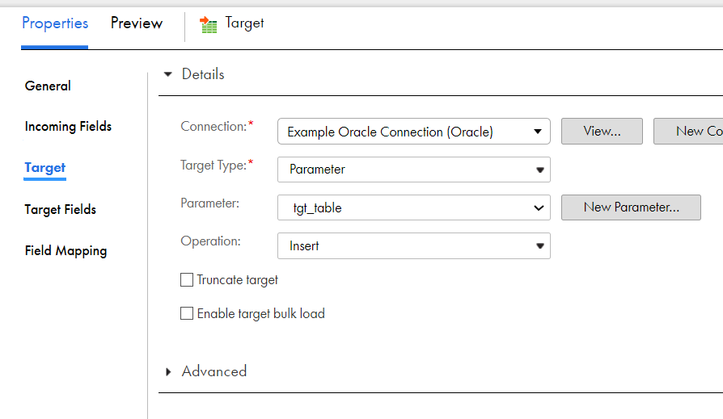
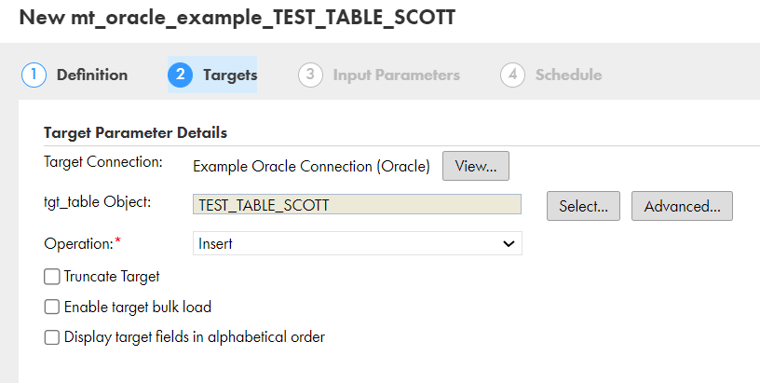
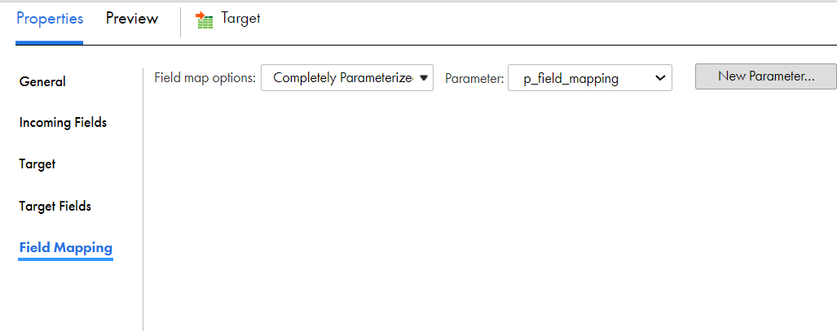
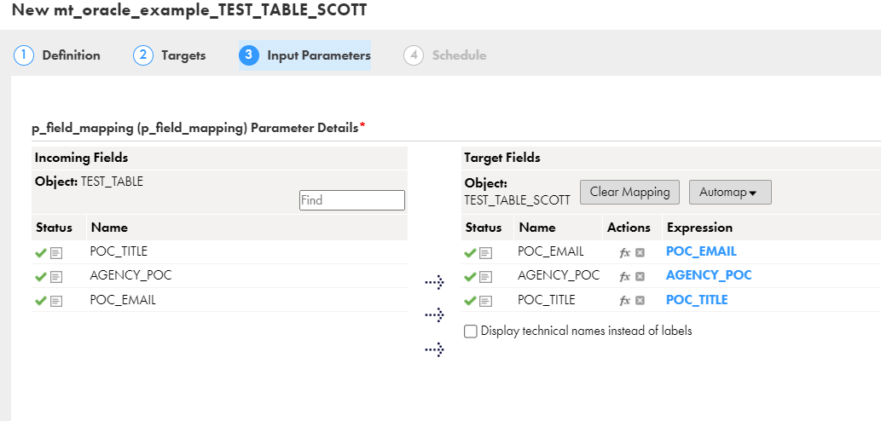
Additional Mapping Task Information
Creating a simple Mapping with parameters
Creating a mapping task with parameters
*These examples can be imported within Cloud Data Integration from the “Example_mapping_task_with_parameters.zip” file.

Slide 38
Thank You
Questions / Issues / Suggestions:
Scott Hayes
shayes@informatica.com

